Slide 1
Software Testing Methodologies
Prashant Joshi

Slide 2
Module 14: Agenda
Module 14: Test Adequacy & Enhancement
Topic 14.1
Test Adequacy – Need & Overview
Topic 14.2
Test Adequacy Assessment – Data Flow
Topic 8.3
Test Adequacy Assessment – Control Flow
Topic 8.3
Examples

Slide 3
Topic 14.1: Test Adequacy – Need & Overview

Slide 4
Is my testing adequate?
Is my testing complete?
Is my testing good enough?
Have I tested my program thoroughly?
Is testing covering all that needs to be covered

Slide 5
Is my testing adequate?
Is my testing complete?
Is my testing good enough?
Is testing covering all that needs to be covered
What do you think?

Slide 6
Some more questions
What is test adequacy?
What are the measures of test adequacy?
If not adequate, How do we enhance tests?
Achievable goals
Feasibility
Error Detection

Slide 7
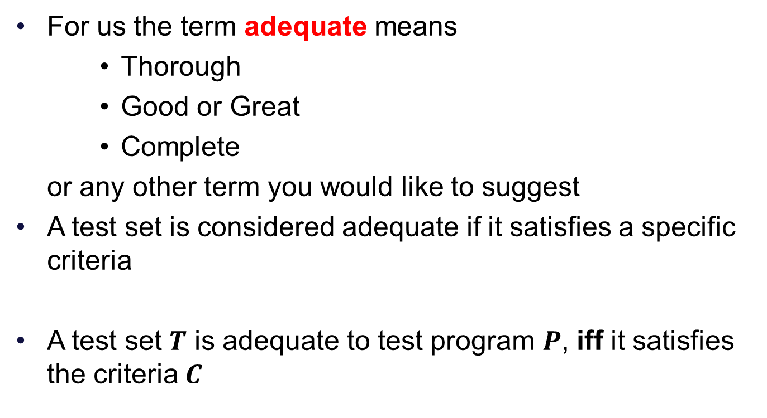
Test Adequacy
For us the term adequate means
Thorough
Good or Great
Complete
or any other term you would like to suggest
A test set is considered adequate if it satisfies a specific criteria
A test set $T$ is adequate to test program $P$, iff it satisfies the criteria $C$

Slide 8
Visual Representation
Criteria
Test Coverage
Establish the criteria
Use appropriate instrumentation
Measure the coverage
Enhance as required

Slide 9
Measurement of Test Adequacy
For each adequacy criterion C, we derive a finite set known as the coverage domain and denoted by Ce
A criterion C is a white-box test adequacy criterion if the corresponding coverage domain Ce depends solely on program P under test
A criterion C is a black-box test adequacy criterion if the corresponding coverage Ce depends solely on requirements R for the program P under test

Slide 10
Test Enhancements using Measurements of Adequacy
Increase the possibility of detecting any uncovered errors
Adequacy does not guarantee an error-free program
Inadequate is a cause of worry for sure
Identification of the deficiency helps in enhancement of the inadequate test set
Measure → Enhance → Adequacy

Slide 11
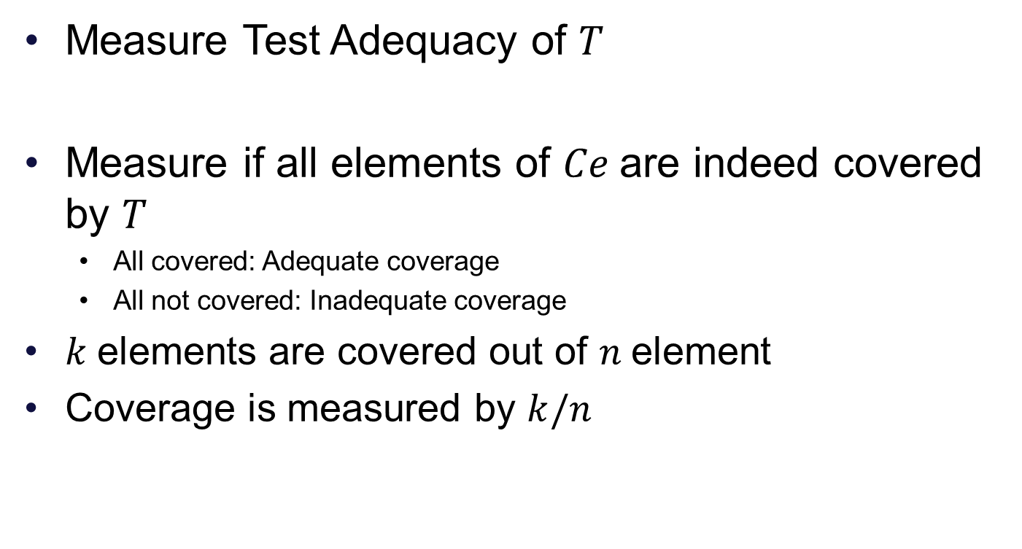
Measurement of Test Adequacy
Measure Test Adequacy of $T$
Measure if all elements of $Ce$are indeed covered by $T$
All covered: Adequate coverage
All not covered: Inadequate coverage
$k$elements are covered out of $n$element
Coverage is measured by $k/n$

Slide 12
Infeasibility and Test Adequacy
An element of a coverage domain e.g. a path, might be infeasible to cover. This implies that there exists no test case that covers such an element
It is quite possible that in spite of detecting the inadequacy an enhancement may not be possible.

Slide 13
Error Detection and Test Enhancement
Test Enhancement → To determine test cases that test the untested parts of the program
Test Enhancement → Uncover new errors of the program by exercising the new areas of the program

Slide 14
Test Adequacy & Execution
Number of times program is executed with certain inputs will enable newer error detection
Single or multiple execution matter
Same input across multiple runs can detect the error which in a single execution may not be possible to detect

Slide 15
Software Testing Methodologies
Prashant Joshi

Slide 16
Topic 14.2: Test Adequacy Assessment – Data Flow

Slide 17
Test Adequacy – Data Flow
The d, u and k
DU Pairs (and other pairs)
c-use & p-use

Slide 18
Infeasible Flow
Nodes are not reachable
Hence cannot determine the Data flow
No test case or input may satisfy the path for the data flow of a variable

Slide 19
Software Testing Methodologies
Prashant Joshi

Slide 20
Topic 14.3: Test Adequacy Assessment – Control Flow

Slide 21
Test Adequacy – Control Flow
Statement and Block Coverage
Conditions and Decisions
Multiple Condition Coverage

Slide 22
Infeasible Flow
Unreachable code – unreachable Control Flow
Uncovers “dead code”

Slide 23
Software Testing Methodologies
Prashant Joshi

Slide 24
Topic 14.4: Examples

Slide 25
Suggested Examples
Review the sample code in T2 Chapter 7 in appropriate sections

Slide 26
Software Testing Methodologies
Prashant Joshi

